Slide 1


Movie Production Recommendations for Microsoft Studios
Jennifer Cobb
Alex Marshall
Patrick Ryan

Slide 2
Outline
Business Problem – Movie Production Planning
Data – Multiple Online Sources
Methods – Genres and ROI
Results – Recommendations & Visualizations
Conclusions - What Movies When
Notes:
Patrick -

Slide 3
Business Problem
Find holes in the market
Get the greatest return on investment
Ensure releases won’t be lost in the crowd
Notes:
Patrick

Slide 4
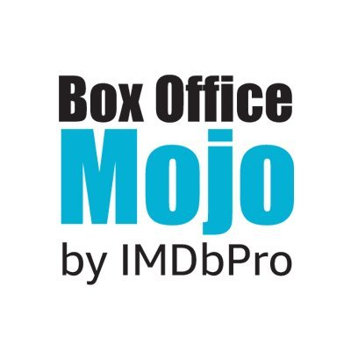



Data
Movie release data from IMDB, The Internet Movie Database, Box Office Mojo and The Numbers collected over a roughly ten-year span.
Includes movies’ budget, box office, studio, and genre.

Slide 5
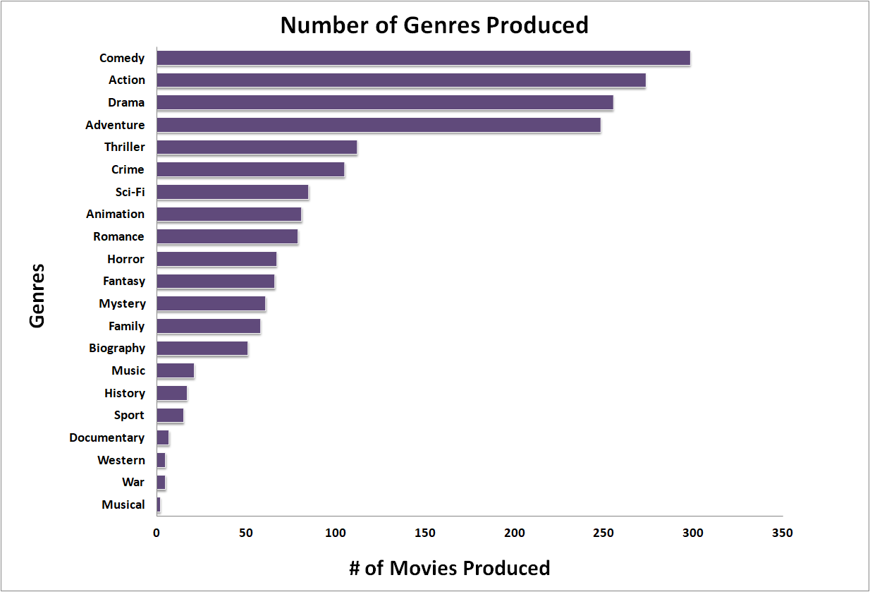
Methods
Linked data from multiple sources
Determined ROI and profit using available financial data (ROI = Gross/Production Budget)
Group data by genre and studio
Notes:
Alex

Slide 6
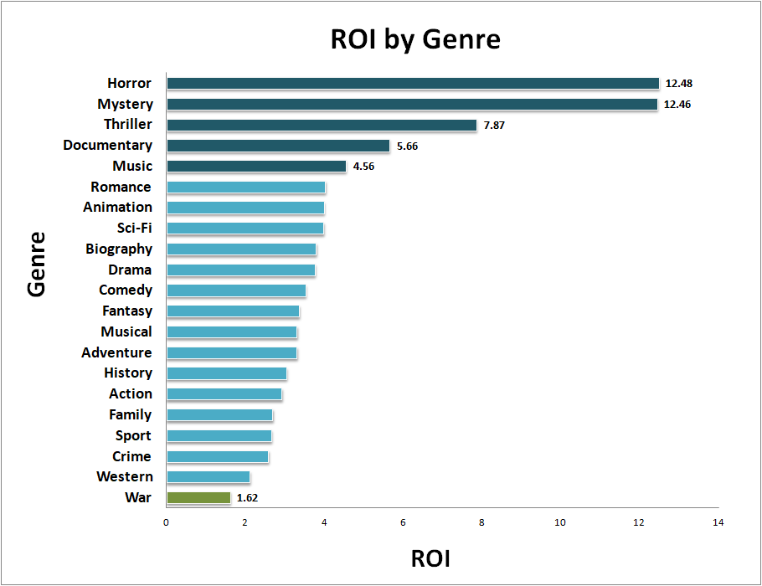
Results
The separation between the first genre and the fifth is much more significant than the fifth and twentieth.
Notes:
Patrick

Slide 7
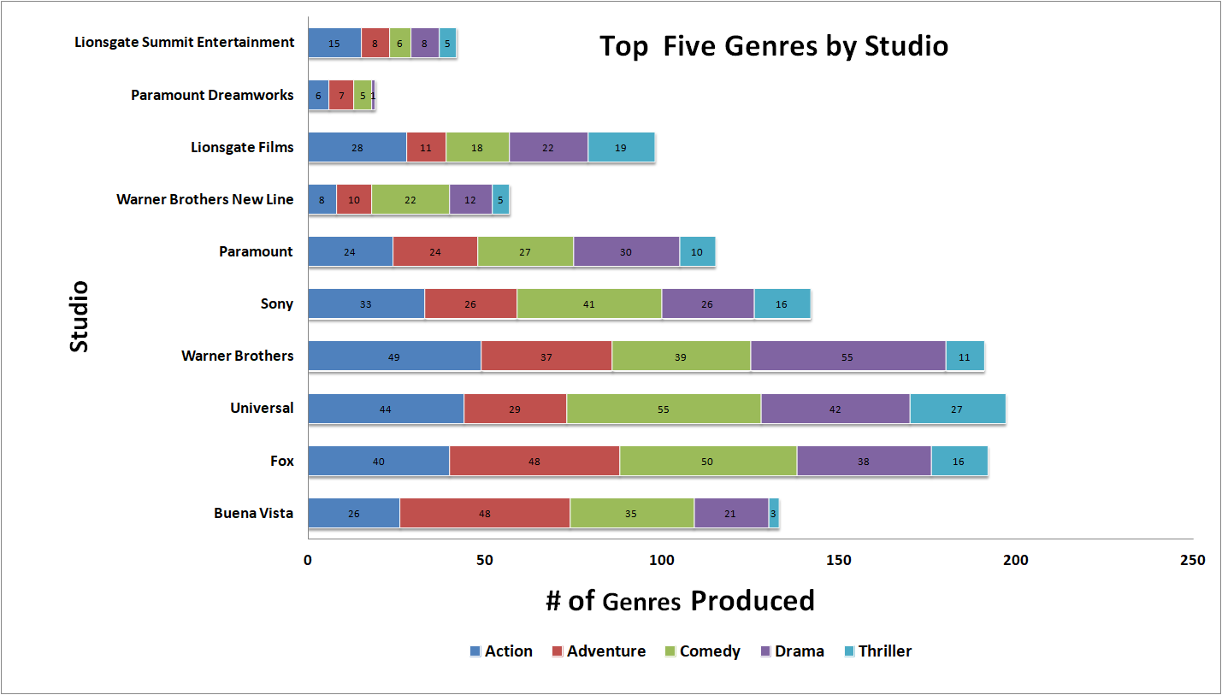
Results
Thriller is the most popular genre with the greatest ROI
Notes:
Jen

Slide 8
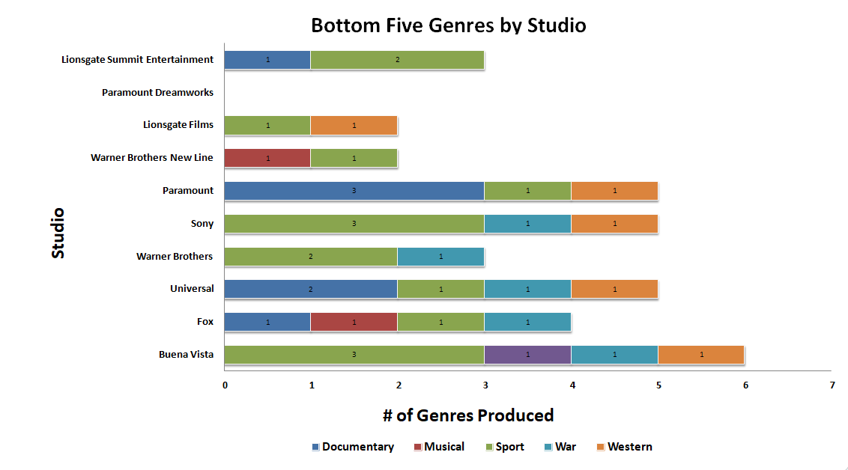
Results
Documentary is least produced with highest ROI
Notes:
Jen

Slide 9
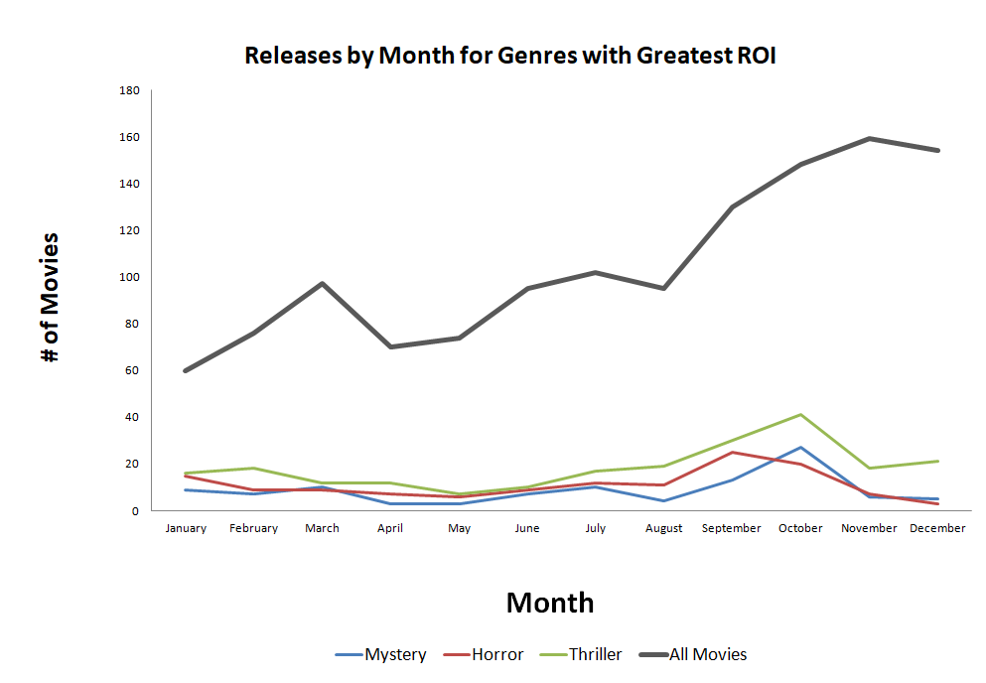
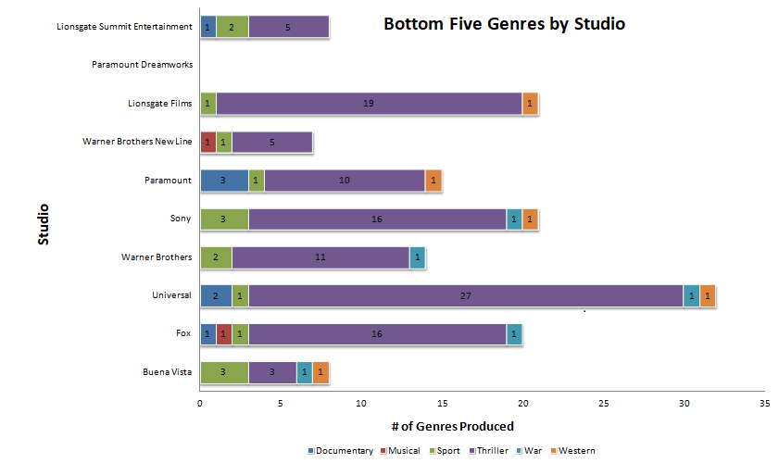
Results
Overall releases increase over course of the year.
Notes:
Jen

Slide 10
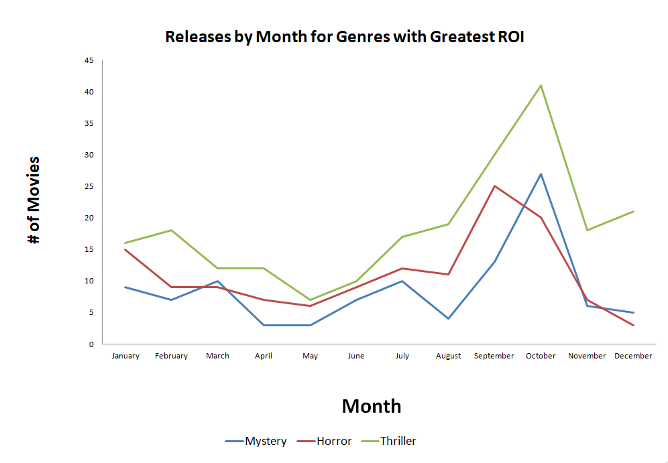
Results
Fewest movies released at the end of the year with another dip in releases over April & May.
Notes:
Jen

Slide 11
Conclusions
Prioritize the best return for their investment to ensure revenue for future products.
Direct competition with established studios should focus on the Thriller genre.
Take advantage of end of year and late spring release lulls to maximize visibility of product.
Notes:
Jen

Slide 12
Next Steps
Examine hybrid genres to see where their trends lay – e.g. horror/comedy or war/musical
Dig into which directors’ films have the best ROI to hire the most efficient filmmakers.
Examine ticket sales number to see which genres get people into the theater.

Slide 13
Thank you!
NE
Patrick Ryan
Jennifer Cobb
Alexandra Marshall
NEPTUNE CONSULTING
consulting@neptune.com

